Slide 1


Slide 2
What is Records
Documented proof of a transaction.
Or Any written or recorded item in the school is a record
i.e any activity which falls within the routine of normal activity of an organization
Records, therefore, are an important means of accountability because they provide proof.

Slide 3
Introduction
School records are books, documents, diskettes and files in which are embodied information on what goes on in school

Slide 4
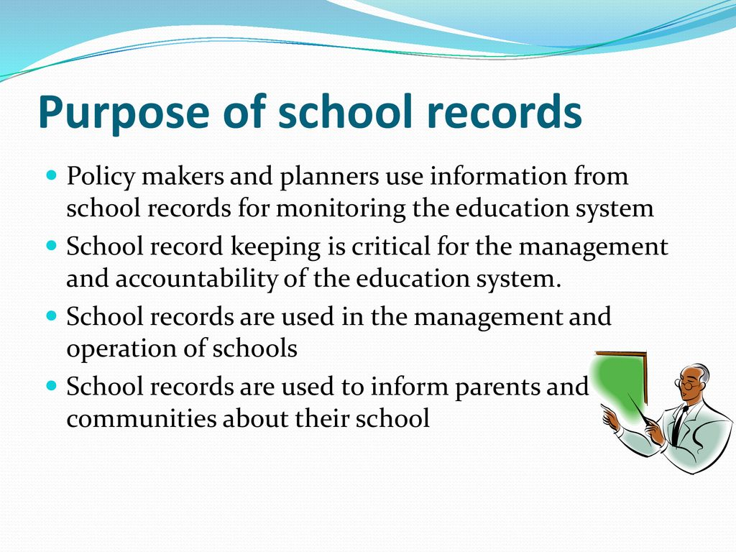

Slide 5
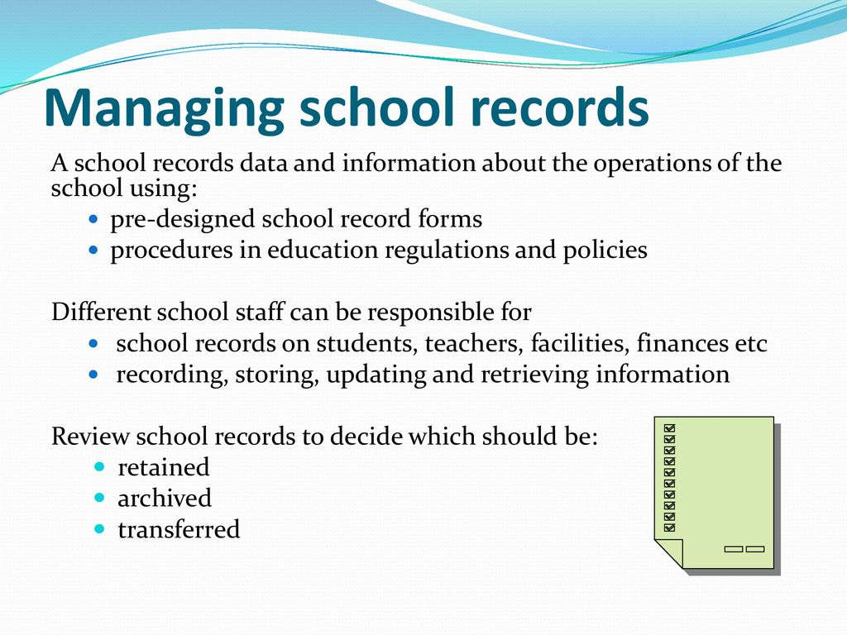

Slide 6
Record Management
R M involves the storage, retrieval and use of information.
i.e “the application of systematic and scientific control to all the recorded information that an organisation needs to do business.”

Slide 7
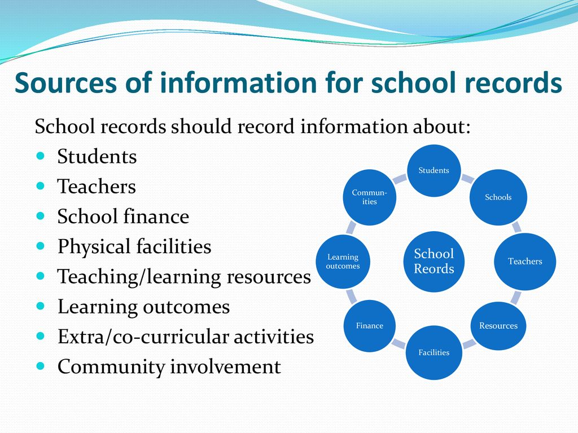

Slide 8
Classification of School Records
General Records
Log book
Visitors' book (specific and general)
Staff record
Punishment book

Slide 9
Teachers’ Records
Attendance register
Leave register
Register of private tuitions of teacher
Confidential record
Teacher's diary

Slide 10
Pupils’ Records
Attendance register
School leaving certificate
Cumulative record card Admission record

Slide 11
Equipment Records
Dead stock register
Laboratory register
Library register
Stationery issue book
Stock and issue of sports material
Inventory of infrastructural facilities

Slide 12
The Visitors book
The book is meant for recording the visit of important personalities, including officials from the ministries of education or other related government agencies or any other school related visitors.

Slide 13
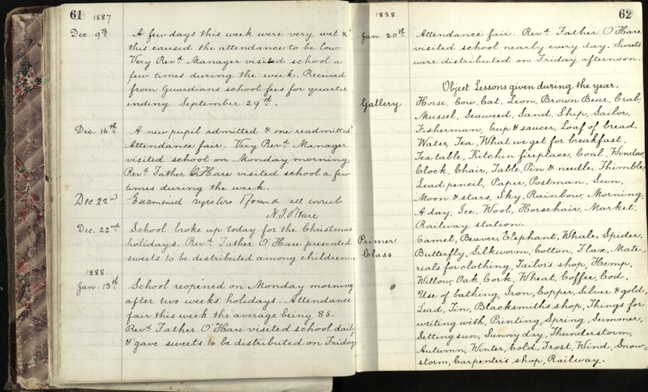
School log book
A book showing a series of events in particular school context
Can tell us about:
the day to day running of the school and
what classes and subjects were taught,
who visited the school
any unusual events that happened

Slide 14
Corporal punishment book
The book contains the names of pupils who create disciplinary problems in school and the nature of punishment awarded mostly canning, flogging, whipping and hard knocks.

Slide 15
Admission and withdrawal Register
This is a permanent record book into which is entered information regarding the entry and exit, including the details of the education and progress of each pupils that ever passes through the school

Slide 16
Teacher and administrative staff records
Teacher and administrative records provide information on the personnel in a school; those who teach as well as those who do not.
These records include details on the availability of personnel in terms of qualifications, age and sex.
The records give an overall picture of the availability of staff.

Slide 17
Attendance Register
An attendance register is a book in which the presence or absence of students in a school is recorded on a daily basis.
It is a statutory record that must be kept by every school. This record is kept on individual class basis.
The class teacher is the custodian of this record.

Slide 18
Scheme and record of work book
It reflects estimate of academic work which a teacher expects to accomplish in each subject based on number of lessons he will have during each term.
x
In every beginning of the term every teacher have to send his/her scheme to academic office

Slide 19
Why scheme Records?
it assists head teachers or educational administrators to know what is being taught in school.
It assists in enforcing accountability and continuity in the work of school.
It clearly shows teacher adherence to the syllabus and how and when the work is done.

Slide 20
Cont….
it is a means of evaluating teachers competency and efficiency.
It helps to handle over the lesson to other teacher in case of transfer, sickness or death

Slide 21
School Time-Table
It provides information on when classes begin, when school opens and closes.
It shows activities to be performed by the teacher and student.
It assists in regulating the activities of students and staff of a particular school.
It facilitates and enhances student interest and attention and prevent mental and physical strain..

Slide 22
Class Timetable
Are a records which shows how, when and where classes are held.
These keep students organized and informed about upcoming classes and help students to manage their time and schedule.

Slide 23
School Diary
The school diary, also known as a teacher’s record of work, shows the things that are to be done and have been done each term for each class/subject in a school.
This record helps to keep teachers motivated and on task (to complete the syllabus by the end of the term) and ensures continuity.

Slide 24
Staff time Book and Movement Book
They provides information on when staff report and or close at work.
They promote regular attendance and punctuality
They help checking truancy and gross indiscipline in staff.

Slide 25
The school cash Register
Financial summary records contain the essential information from the revenue and expenditure records.
The summary form for revenue reflects all the incoming funds over a specified period.
There are two types of financial summary forms: one for general revenue and one for expenditure

Slide 26
Why should financial records in school?
It is a records of financial transactions in schools
It gives information about income and expenditures
It promotes accountability and prevent corrupt and sharp practices.
It is very useful in planning school development

Slide 27
Mark schedules
It shows pupil performance in various tests and assignments, including end-of-term class tests. The record also gives the overall comparative results of each pupil.
Purpose
consistently record the performance of individual pupils

Slide 28
Cont;
show the comparative performance of the class
collect information for completing the pupil record cards
facilitate the preparation of progress reports

Slide 29
Individual Record Card
This is a continuous record or a combination of records that contain comprehensive information about a student.
It provides a summary of a student’s academic progress in school and also includes the student’s name, age, date of birth, date of admission, family background, social or extracurricular activities.

Slide 30
Cont’
It contains certain particulars as well as a summary of information on every pupil attending the school.
The purpose of the card is to:
Provide summarised information about individual pupils

Slide 31
Cont’
show specific information regarding; the background of the pupil, physical characteristics e.tc
provide a basis for any necessary attention the pupil may need
supply information of the pupil in case of transfer.

Slide 32
Pupil Records Cards
Comprise a whole range of records containing information on pupils.
This covers, for example, applications, admissions, academic and social welfare, etc.
It also include letters from parents, copies of letters to the parents concerning the pupils, and so on.

Slide 33
Cont’
Pupil record form can provide information for guidance and counselling to the pupils and daily management of pupil affairs at the school.
xxxxxxxxxxxxxxxxxxxxxx

Slide 34
Health Record Book
Are records of the names of students who were ill and sent to local health centers, school sick bays or the hospital for treatment. These records indicate the nature of the sickness and the treatment administered.

Slide 35
School Stock Book
The school stock book shows the current supply of equipment and other materials in the school. It is usually divided into two parts.
a) showing the consumables items (chalk, dusters, diary, registers, etc.)
b) showing non-consumable items (furniture, television, tape recorders, sporting and athletic equipment, etc.).

Slide 36
The life cycle of a record
Each record has a life cycle. There is a stage when a record is active. It is then referred to as an active record. During this phase the record is in full use.

Slide 37
Cont’
creation and distribution
use
retention
storage
retrieval
protection
preservation
final disposal
Each of these has a direct influence on the availability of information

Slide 38
Characteristics of good record management by Ibara (2010)
Completeness
Cost
Flexibility
Quality
Relevance
Retention and Disposition of Records

Slide 39
Cont’
Timeliness
Maintenance

Slide 40
Completeness: Complete and comprehensive records should be kept to give users all the information needed to plan and make effective decisions.
Cost: Records should not be too expensive to keep. This means that the financial cost of collecting, analysing, synthesizing, storing and retrieving records should be low.

Slide 41
Flexibility: Data is flexible if it can be used by more than one user at different times for different purposes.
Quality: The quality of any information contained in any record must be accurate and reliable. The greater the accuracy and reliability, the higher the quality of information, and the more likely the information system is to work well.

Slide 42
Relevance: A relevant record is one that is useful to the needs of the system. A good deal of irrelevant information is kept, particularly in schools. Data that is no longer relevant and not required by law should be securely disposed of.

Slide 43
Retention and Disposition of Records: The disposition of records does not entirely mean destruction. Disposition can also include transfer of records to a historical achieve, to a museum, etc. In the case of schools, however, most records are disposed of when no longer needed. The public officials concerned may destroy these records upon expiration of the retention period.

Slide 44
Timeliness: Information contained in a record should be retrievable as it is needed rather than after important decisions have been made.
Variability: This refers to the degree of consensus arrived at among various users examining the record. The greater the consensus among users, the more accepted the record.
Maintenance: The maintenance of records involves all activities that ensure that they are in good condition, and kept in an orderly state. This is a central function of records management.

Slide 45
Importance of keeping Record
Helps in in the following;
decision making
Employment
Guidance counselor
Accountability
Information bank
Information for parents

Slide 46
Cont’
Planning
Student academic achievement and behaviour
Subject time table
Supervisors/Inspector

